Slide 1

Classification of the Motor Imagery Signals for Brain-Computer Interface (BCI) Comprehensive Viva-Voce Examination
Presented By
Gouthami V
Roll No.: 406821001
Research Scholar(part-time)
Guide
Dr. B. Shameedha Begum Assistant Professor
Department of Computer Science and Engineering National Institute of Technology Tiruchirappalli September 30, 2022

Slide 2
Data Sheet
Details
Date of Registration : 27.08.2021
Area of Research : Brain-Computer Interface
Doctoral Committee meeting convened : 28.09.2022
Course work Details:
S.No | Subject code & Title | Month & Year of Exam | Grades
1 | CS605 - High Performance Computer Architecture | Dec – 2021 | B
2 | CS610 - Advanced Network Principles and Protocols | Dec – 2021 | B
3 | CA605 - Machine Learning Techniques | Dec – 2021 | A
4 | CC801- Research Methodology | Dec - 2021 | B
CGPA obtained |  |  | 8.5

Slide 3
Overview
Introduction
Electroencephalogram(EEG)
Motor Imagery
Literature Survey & Research Gaps
Problem Statement
References

Slide 4
Brain-Computer Interface
A brain-computer interface (BCI) is a computer-based system that acquires brain signals, analyzes them, and translates them into commands that are relayed to an output device to carry out a desired action.

Slide 5
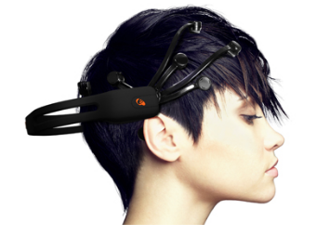
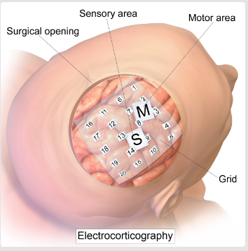
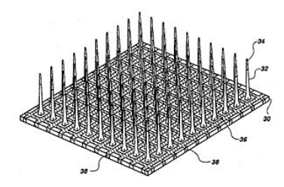
BCI Signal acquisition methods
Non-invasive | The sensors are placed on the scalp to measure the electrical potentials produced by the brain (EEG) or the magnetic field (MEG)
Semi-invasive | The electrodes are placed on the exposed surface of the brain(ECoG).
Invasive | The micro-electrodes are placed directly into the cortex, measuring the activity of a single neuron.
EEG is the most common used because of the cost and hardware portability.

Slide 6
Types of BCIs
Active BCI-results from voluntary controlled activities(Motor Imagery)
Reactive BCI- brain signals arising as a result of reaction to external stimulant.
Passive BCI-This system gets its results from unintentional affective/cognitive brain activities of brain.

Slide 7
Electroencephalogram(EEG)
EEG
Records electrical activity of the brain
Picks up electrical potential and brain wave patterns
Effective medical imaging tool
Advantages
Non-invasive, Cost efficient & Mobility
High temporal resolution.
Relatively tolerant to movement of subject

Slide 8
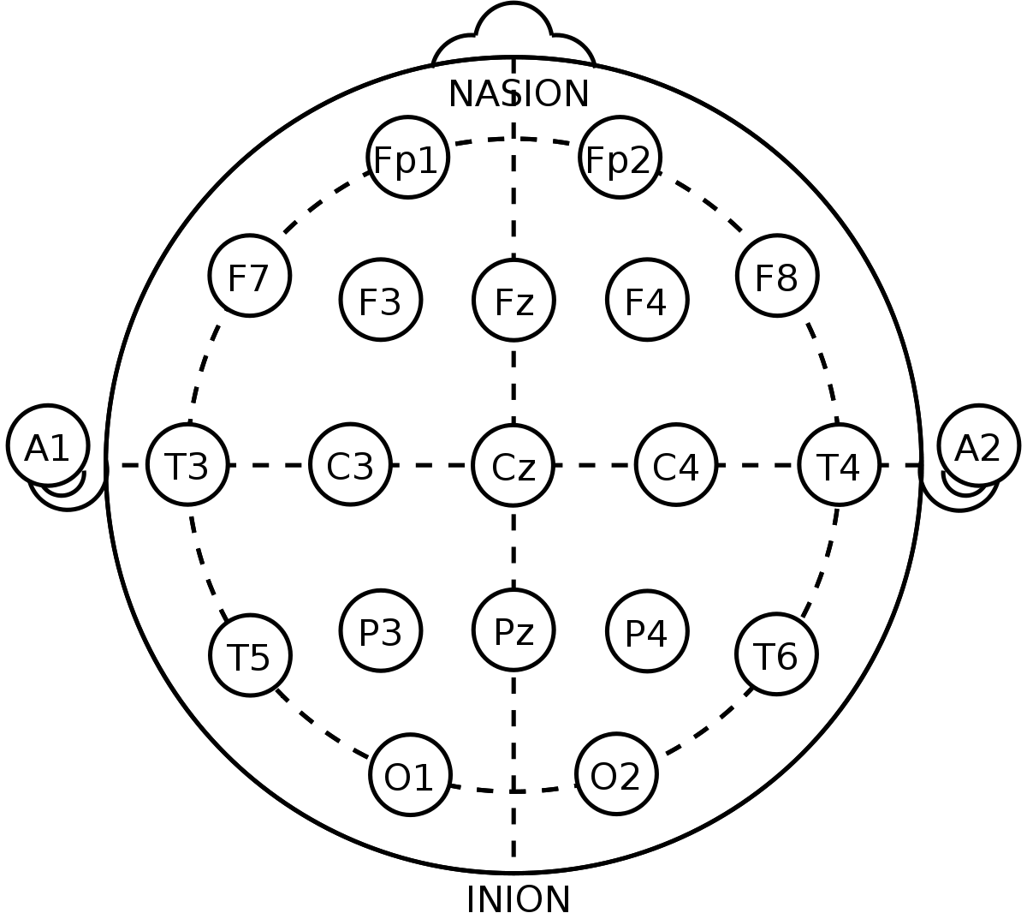
Electroencephalogram(EEG)
Figure 1:10-20 electrode placement system

Slide 9
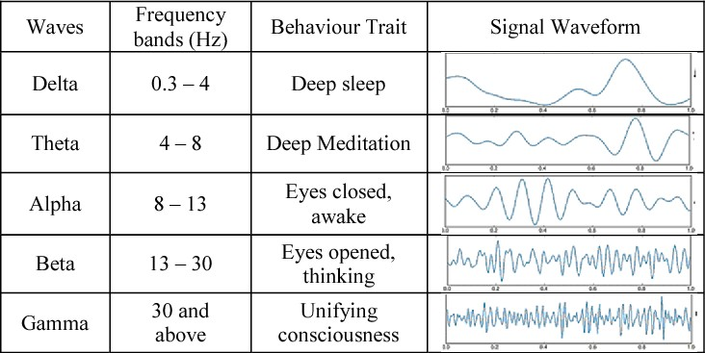
Electroencephalogram(EEG)
Figure 2:EEG Frequency bands

Slide 10
Introduction
Motor imagery is a cognitive process in which a subject imagines that he/she performs a movement without actually performing the movement.
act as a substitute for the imagined behavior.
What is motor imagery EEG?
A Motor Imagery-based Brain-Computer Interface (MI-BCI) creates a path through which the brain interacts with the external environment by recording and processing EEG signals made by imagining the movement of a particular action.

Slide 11
Types of Motor Imagery
Kinesthetic Motor Imagery (KMI)
Ability to imagine performing a movement.
Impression of the muscle contraction and sensation.
Visual Motor Imagery (VMI)
Ability to imagining seeing oneself performing the movement.

Slide 12
Literature Survey
S.No | Author | Paper | Year | Journal | Findings
1 | Jin Et Al.: | Novel Classification Framework Using Graph Representations Of EEG. | 2022 | Expert Systems With Applications | Synchronous collaboration between different regions of the brain. The local structure extraction matrix can effectively extract features.
2 | Huiyang Wang A,B , Hua Yu | EEG_GENET: A Feature-Level Graph Embedding Method For Motor Imagery Classification Based On EEG Signals | 2022 | Biocybernetics And Biomedical Engineering | Decoding of raw EEG Motor Imagery signals is explained and compared between two datasets.
3 | Duan Et Al | ZSL For EEG classification In MI-Based BCI System. | 2022 | IEEE Transactions On Neural Systems And Rehabilitation Engineering, | Help to extend the types of imagination tasks without increasing calibration time. Used a new type of motor imagery task to expand the MI command set, that is, imagine the left and right hands moving simultaneously.
4 | B. Xu Et Al | Phase Synchronization Information For Classifying Mi EEG From The Same Limb | 2021 | IEEE Xplore | Motor Imagery classification is done using Deep Learning model and is performed on Single limb.
5 | J. F. Hwaidi, T. M. Chen | Classification Of Motor Imagery EEG Signals based on Deep Autoencoder and Convolutional Neural Network approach | 2021 | IEEE Access | capable of distinguishing between MI tasks within subjects. Number of electrodes can be reduced even further.

Slide 13
Literature Survey
S.No | Author | Paper | Year | Journal | Findings
6 | Wenqie Huang A ,Wenwen Chang | EEG-Based Motor Imagery Classification Using Convolutional Neural Networks with local reparameterization trick. | 2021 | Expert Systems With Applications | Classification by using Deep Learning Method is performed on group of people and individually. Classification accuracy is seen more in individual subject.
7 | Yu Zhang1 , Huaqing Li2 , | Transfer Learning Algorithm Design for feature transfer problem In Motor Imagery Brain-Computer Interface | 2021 | Brain-Computer-Interface Inspired Communications | Nonstationary of the MI-EEG Signal and the changes of the experimental environment reduces the classification accuracy of MI-BCI.
8 | Sun Et Al.: | Adaptive Spatiotemporal Graph Convolutional Networks for Motor Imagery classification | 2021 | IEEE Signal Processing | Adaptively determines the Importance of neighbor nodes and extracts the features in the time domain at the same time.

Slide 14
Research Gaps
Research Gaps
The consistency of the accuracy of the classifier during long sessions is one of the issue as EEG signals are non-stationary.
Changes in EEG signal is seen when there is a change in recording environment and state of mind.
No detailed analysis on active brain regions and predominant EEG channels.
o

Slide 15
Problem Statement
This research work aims
Designing BCI model to classify Motor Imagery tasks with better accuracy which would be helpful to the neuro rehabilitation patients who lost their physical movements.
Research Objectives
To collect brainwave signals of different Motor Imagery tasks performed using a non-invasive EEG.
To analyze the EEG signals collected from the scalp using adaptive methods and identify Motor Imagery actions.
To analyze active brain regions and predominant EEG channels.
To design a new model to classify the Motor Imagery tasks with better accuracy.

Slide 16
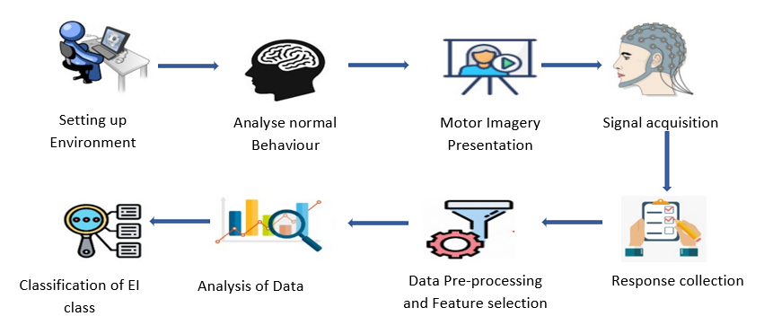
Experimental Procedure
Figure 3:Experimental Procedure

Slide 17
References
Jamal F. Hwaidi And Thomas M. Chen. Classification of Motor Imagery EEG Signals Based on Deep Autoencoder and Convolutional Neural Network Approach,IEEE Access,10,48071-48081,2022.
Jing Jin , Senior Member, IEEE, Hao Sun, Ian Daly , Shurui Li , Chang Liu , Xingyu Wang, and Andrzej Cichocki, A Novel Classification Framework Using the Graph Representations of Electroencephalogram for Motor Imagery Based Brain-Computer Interface, IEEE Transactions On Neural Systems And Rehabilitation Engineering, VOL. 30, 20-30,2022.
Yu Zhang, Huaqing Li, Heng Dong, Zheng Dai, Xing Chen, Zhuoming Li, Transfer Learning Algorithm Design for Feature Transfer Problem in Motor Imagery Brain-computer Interface, Brain-Computer-Interface Inspired Communications,39-46,2022.
Biao Sun , Member, IEEE, Han Zhang , Zexu Wu, Yunyan Zhang, Adaptive Spatiotemporal Graph Convolutional Networks for Motor Imagery Classification, IEEE Signal Processing Letters, Vol. 28, 219-224, 2021.

Slide 18
References
Lili Duan , Jie Li, Hongfei Ji, Zilong Pang, Xuanci Zheng, Rongrong Lu, Maozhen Li , and Jie Zhuang, Zero-Shot Learning for EEG Classification in Motor Imagery-Based BCI System, IEEE Transactions On Neural Systems And Rehabilitation Engineering, Vol. 28, No. 11,2411-2423,2020.
Baoguo Xu, Zhiwei Wei, Aiguo Song, (Senior Member, IEEE), Changcheng Wu ,Dalin Zhang, Wenlong Li, Guozheng Xu, Huijun Li, And Hong Zeng, Phase Synchronization Information for Classifying Motor Imagery EEG From the Same Limb,IEEE Access,153842-153853,2019.
Jamal F. Hwaidi And Thomas M. Chen, Classification of Motor Imagery EEG Signals Based on Deep Autoencoder and Convolutional Neural Network Approach,10,48071-48082,2022.
Wenqie Huang, Wenwen Chang , Guanghui Yan , Zhifei Yang, Hao Luo, Huayan Pei, EEG-based motor imagery classification using convolutional neural networks with local reparameterization trick, Expert Systems With Applications,187,1-14,2021
Huiyang Wang, Hua Yu, Haixian Wang, EEG_GENet: A feature-level graph embedding method for motor imagery classification based on EEG signals, Biocybernetics and Biomedical Engineering,42(3), 1023-1040,2022.

Slide 19
THANK YOU

